Slide 1
Hardware
IoT BASED ICU PATIENT MONITORING SYSTEM
Presented By
B. Bhavya Sai Chandrika-22B01A0208

Slide 2
CONTENTS
Introduction
Literature Review
Problem Statement
Objectives
Block Diagram
Components & Specifications
Gantt Chart
References

Slide 3
Introduction:
Intensive Care Unit or ICU is where the patients who are critically ill are admitted for treatment. For such critical conditions the Doctors need to have an all-time update patient’s health related parameters like their blood pressure, heart pulse and temperature. For this type of situations this IoT based system can bring about an automation that can keep the Doctors updated all time over internet.
IoT Based ICU Patient Monitoring System which collects patient’s information with the help of few sensors. There is a Blood pressure and heart beat monitor module electrically connected to the system. On the press of button, the sensor senses the blood pressure in systolic and diastolic along with the heart beat and sends it to the central controller. The Temperature sensor senses the temperature of its ambience, so when this sensor is in close proximity of the user it reports the users’ body temperature. In this way IoT Based ICU Patient Monitoring System is an enhanced system that helps in monitoring ICU Patients without any manual intervention.

Slide 4
Problem Statement:
Design and implement an IoT-based ICU patient monitoring system that allows real-time monitoring of vital signs and conditions of patients in intensive care units.

Slide 5
Objectives:
The goal of monitoring the patient is to detect problems and manage them as early as possible.
To sustain life
To prevent , reverse or minimize damage to vital organs.
Develop a mechanism for real-time transmission of sensor data from the patient to a central monitoring system.
Implement an alarm system to alert healthcare providers in case of abnormal vital signs or critical changes in the patient's condition.

Slide 6
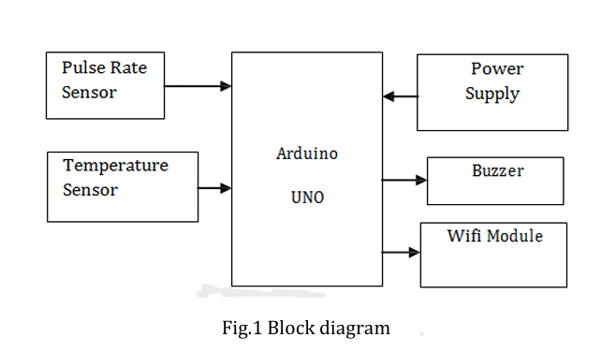
Block diagram:

Slide 7
Components & Specifications:
Hardware Specifications :
Power Supply(9V)
LCD Display
Temperature Sensor(LM35)
Pulse rate Sensor
WIFI module-ESP8266
Arduino UNO
Buzzer

Slide 8
Hardware testing and implementation stage:
The hardware testing and implementation stage of our IoT-based ICU patient monitoring system involves rigorous testing of the sensors and other hardware components to ensure seamless integration and accurate data transmission.
We conduct functional testing of the sensors to ensure precise monitoring of vital signs, such as heart rate, blood pressure, and temperature.
Our team ensures proper installation and maintenance of the hardware to guarantee optimal performance and patient safety.

Slide 9
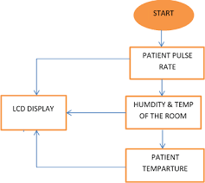
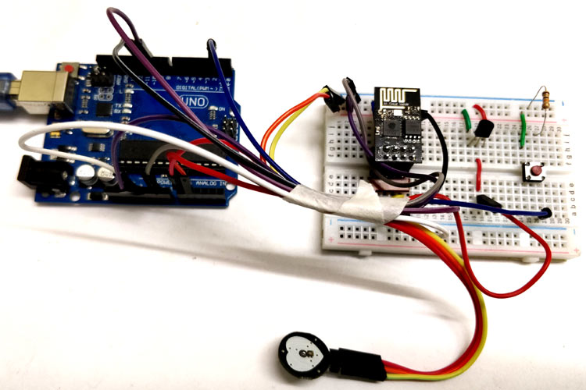

Slide 10
Thank You
&
Any Queries ?

